Slide 1

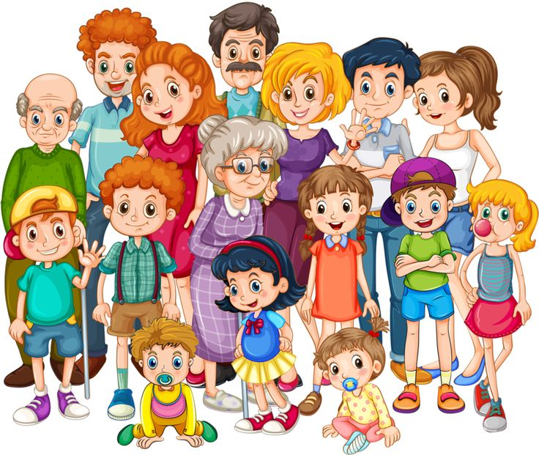

BIGGEST
BLENDED FAMILY
Do you have a HUGE blended family?
Are you the SUPER-SIZED Brady Bunch?
Did you and your spouse both bring a TON
of kids into a new marriage?
WE WANT TO HEAR FROM YOU!
Please send a quick bio about your unique family to:
coasttocoastcasting@gmail.com
Now
Casting

