Slide 1
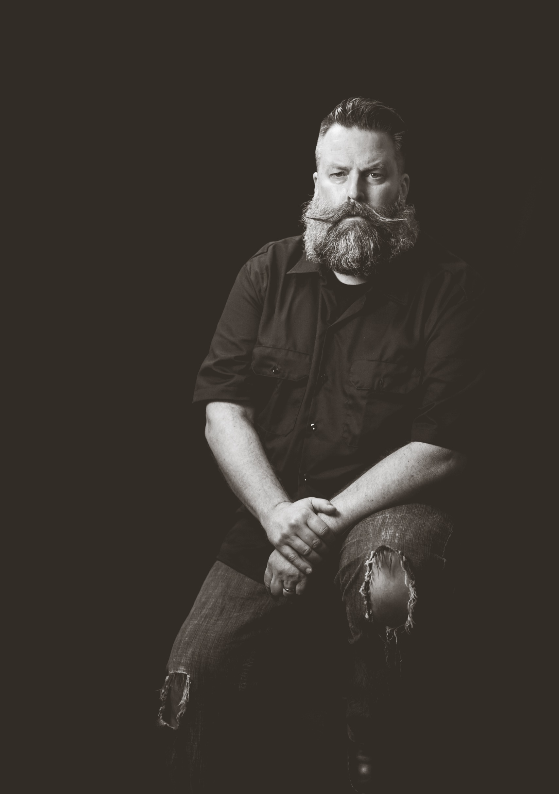
OPEN CASTING CALL
EraLight Studios of East Texas is seeking talent for upcoming productions in the 2018 season.
Saturday, May 19th
^{10AM-4PM}
Maude Cobb Convention Center
100 Grand Blvd, Longview, TX 75604
Open to actors of ALL ages,
ALL levels of experience.
Please prepare a short monologue.
Headshots and resumes preferred but
not required.
We are also accepting
video submissions by email.
For more information,
Call (903) 471-4267
Email: EraLightStudios@gmail.com
Facebook.com/EraLightStudios/

